Slide 1
Ready2® … Programs

Slide 2
Entrepreneurship/Start-Ups Worldwide:
There are close to 400 million entrepreneurs worldwide.
80% of entrepreneurs funded their business out of pocket.
Founders of the companies with the highest growth clocked in with an average age of 45.
While it is true that 51.6% of businesses started out running from someone’s home, many of those entrepreneurs were well educated.
39% of business owners have a bachelor’s degree or higher.
95% of the business founders surveyed by the Kauffman Foundation had at least a bachelor’s degree, 47% had even more advanced degrees.
Company founders were 125% more successful if they had worked previously in a similar industry as their new companies.
At an average of 10% across 51 different economies, the growth rate for women as entrepreneurs hit 10%, higher than the comparative 5% growth rate for men.
At the end of 2017, nearly 1.2 million people all over the globe had spent time working from a co-working space.
Co-working spaces have grown an impressive 89% in the previous 12 months, and 300% since 2010.
Almost 50% of entrepreneurs work 50+ hours per week; and 19% work more than 60 hours per week.
Yet, 73% of the business people surveyed said their hours were more flexible now than when they worked for someone else.
Entrepreneurship Ecosystem Will Grow!
The United States ranks 1st out of 138 countries using the Global Entrepreneurship and Development Index, in providing environment for promoting start-up ecosystems.
Being an entrepreneur takes a certain personality type to truly be successful; problem-solving, flexibility and self-discipline are key.
20% of new companies fail in their first year, and only 50% survive through their fifth year.
We Need to Increase Their Success & Sustainability!

Slide 3
Thus, We Need To Get the (Potential)
Entrepreneurs
Investors
Mentors
Start-Ups
Intrapreneurs
Scale-Ups
… And Other Stakeholders
Ready with the Awareness, Knowledge and Skills Needed to Grow!

Slide 4
Ready2...Programs – Portfolio
Ready2®Entrepreneur Program for Entrepreneurs
Ready2®InnoVest Program for Investors
Ready2®InnoEntry Program for Potential Entrepreneurs
Ready2®Intrapreneur Program for Leaders/Intrapreneurs

Slide 5
Ready2®Entrepreneur Program for Entrepreneurs

Slide 6
Ignite Program – Objective and Goals
Mature Up Ideas
Scale-Up Capabilities of the Entrepreneurs, Mentors and Investors through a Systematic Readiness Program that will help them mature their entrepreneurial ideas and concepts in order to go-to-market
Design and Delivery of a Wholistic ‘Ignite’ Program That Would Increase Capabilities,
Visibility,
Access to Funding and Growth of the Ecosystem.
Access to Funds
Increase visibility of Entrepreneurs and their ideas/concepts, equip them with the right tools and attitude so that they can ‘connect’ with the Investors and get funding as found appropriate
1
GOAL ONE
Strengthen Ecosystem
Get all parties together that would nurture an ecosystem of entrepreneurship, and ensure growth of a robust and sustainable ecosystem
2
GOAL TWO
3
GOAL THREE

Slide 7
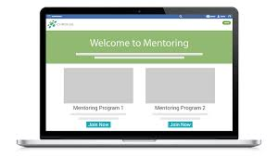
Ignite Program – Roadmap
Readiness 4 Entrepreneurs
Staging
Readiness 4 Mentors
Certification
The Deal
Readiness 4 Investors
Ready2Start-Up

Slide 8
Ignite Program – Readiness Modules
Mentoring 1:1
E7-Piloting/Prototyping
Active Learning
Self-Study
Mentoring 1:1
E4-Business Planning
Active Learning
Self-Study
Mentoring 1:1
I2-Win:Win Investments
Active Learning
E5-Business (Go-To-Market) Modelling
Active Learning
Self-Study
Mentoring 1:1
E8-Selling Ideas/Concepts
Active Learning
Self-Study
Mentoring 1:1
E9-Investment Readiness
Active Learning
Self-Study
Mentoring 1:1
E1-Entrepreneurship 101
Active Learning
Self-Study
Group Coaching
I1-Investorship 101
Active Learning
E6-Project Planning
Active Learning
Self-Study
Mentoring 1:1
M1-Mentorship 101
Active Learning
E2-Design Thinking
Active Learning
Self-Study
Group Coaching
E3-Dream2Live Design-Inno Workshop
Design Workshop
Self-Study
Group Coaching

Slide 9
Ignite Program – Entrepreneurship 101
E1
Stage 1 | Objective | Content | Methods | Tools | Time | Duration
Active Learning | to develop insight as to: Entrepreneurship overall; key success factors and competencies for being an entrepreneur; own capabilities and competencies in order to become and move on as an Entrepreneur. | Who is an Entrepreneur (E)? The Risks and Rewards of Entrepreneurship Key Competencies of an Entrepreneur How Do Entrepreneurship Ecosystems Work? Stories from (experienced) Entrepreneurs | Seminar Workshop Exercise Speakers/Panel | Game-Find the Entrepreneur In You Assessment-Competencies Mapping Panel/Q&A-with Story-Tellers | Program Kick-Off+2 Weeks | 1 Day
Self-Study | to contemplate on learnings and self-assessment outcomes out of Active Learning session in order to become aware and define key requirements to move on as an Entrepreneur | Review Learnings and Outcomes | Thought Process | Entrepreneurship Ignite Assessment Personal SWOT Analysis Template | Stage 1 Active Learning+1 Week | 2 Hours
Get Support of Others | to learn from each other’s self exploration, get others’ guidance and ideas as to how to move on as an Entrepreneur and get ready for Stage 2 | What was key insight out of Active Learning? How did you assess yourself as an Entrepreneur? In which areas you feel more competent? How would you leverage your strengths? In which areas you feel less competent? What is the impact of your weaknesses? How would you plan to develop yourself as an Entrepreneur? | Discussion Peer-Coaching by Program Participants | Personal Action Plan Template Readiness Check-List | Self-Study+2 Weeks | ½ Days
An Example of a Module

Slide 10
Ready2®InnoVest Program for Investors

Slide 11
Invest Program – Objective and Goals
Know How to Think
Increase awareness and knowledge level of Potential Investors in terms of what it takes to become an Investor in a world of digitalization, and how Design Thinking can help in effective transformation/commercialization of projects.
Design and Delivery of an Agile ‘Invest’ Program That Would Increase Awareness, Knowledge and Skills of Potential Investors!
Know How To Act
Increase knowledge level of Potential Investors as to Innovation Models across industries and Business Modelling as a way of connecting the dots.
1
GOAL ONE
Know How to Invest
Equip Potential Investors with techniques required to assess, mentor and invest in win-win (technology) projects; so that they become effective in investments.
2
GOAL TWO
3
GOAL THREE

Slide 12
Invest Program – Roadmap
Module I
Module II
Module III
Digital Transformation
Ten Types of Innovation
Mentoring
Design
Thinking
Business
Modelling
Investing
Certification
Day 1
1 month
Day 2
1 month
Day 3

Slide 13
Invest Program – Know How To Think
M1
Sessions | Objective | Content | Methods | Tools | Time | Duration
Digital Transformation | to develop insight as to: Global trends What is digitalization What is digital transformation What different companies and industries are doing in terms of digital transformation How it is different compared to traditional business How can they generate strategies | A-VUCA World The World in 2030’s How Do The ‘Most Innovative Companies’ Transform? New Digital Technologies Example-Future Farms, Smart Cities, Cars as Platforms.. Strategy Development for Digital Transformation | Seminar w. Examples Self-Contemplation Action Planning Open Discussion | 'Action Sheet’ Templates | Day 1 of Program | ½ Days
Design Thinking | to develop understanding as to Design Thinking and how to develop Design-Oriented Organizations. | Design-Oriented Organizations Why & What: Scientific & Creative Problem Solving Designing for Growth: Four Questions, Ten Tools What If-What Is-What Wows-What Works The Design Thinking Process: Empathize-Define-Ideate-Prototype-Test 15 Steps in Design Thinking 10 Tools in Design Thinking | Seminar w. Examples Self-Contemplation Action Planning Open Discussion | Design Thinking Poster 'Action Sheet’ Templates | Day 1 of Program | ½ Days
An Example of a Module

Slide 14
Ready2®InnoEntry Program for Potential Entrepreneurs

Slide 15
Challenge Program – Objective and Goals
Get Ready
Increase awareness of Potential Entrepreneurs in terms of what it takes to become an Entrepreneur, how they can generate creative and new concepts and use Design Thinking for success.
Design and Delivery of an Agile ‘Challenge’ Program That Would Increase Awareness, Knowledge and Skills of Potential Entrepreneurs!
Know How To Plan
Increase knowledge level of Potential Entrepreneurs as to Business Planning and Modelling of their Concepts and increase capabilities through practice.
1
GOAL ONE
Fundamentals of Projects
Increase knowledge and skill level of Potential Entrepreneurs as to how to plan their Projects, plan for financials and move towards Piloting/ Prototyping.
2
GOAL TWO
3
GOAL THREE

Slide 16
Challenge Program – Roadmap
Module I
Module II
Module III
Entrepreneurship 101
Business
Planning
Project & Financial Planning
Design
Thinking
Business
Modelling
Piloting &
Prototyping
Dream2Live® Design-Inno Workshop
Certification
Day 1
1 month
Day 2
1 month
Day 3

Slide 17
Challenge Program – Know How To Plan
C2
Sessions | Objective | Content | Methods | Tools | Time | Duration
Business Planning | to learn why and how a Business Plan is developed and transform current insight into a Business Plan in order to make the next steps 'concrete' and 'actionable'. | What Is A Business Plan? Why Do We Need a Business Plan? Opportunity/Challenge/Expectation Definition What Is The Solution Proposal? The Business Plan: Why Topic Selected: Background/Situation Strategies/Goals and Targets Implementation Actions Resources/Financials / Budgeting Timeline The Team and Organization Definition of Stakeholders | Seminar (Active Learning) Workshop Exercise | Hoshin Kanri Business Plan Template Workshop Coaching & Peer Coaching | Day 3 of Program (1 Month following Module I) | ½ Days
Business (Go-To-Market) Model: Business Canvas as a Strategy & Innovation Model | to learn why and how a promising Business Model is developed and transform current insight and Plans into a Business Model in order to create competitive advantage and differentiation through Value Proposition; structure the Revenue and Cost model. The Business Model will further enhance the Business and Implementation Planning. | What Is A Business Model? Why Do We Need a Business Model? Business Canvas - Target Audience - Channels - Customer Relations - Value Proposition - Key Resources - Key Activities - Key Partnerships - Cost Model - Revenue Model - Key Success Factors | Seminar (Active Learning) Workshop Exercise | Business Canvas Template Workshop Coaching & Peer Coaching | Day 3 of Program (1 Month following Module I) | ½ Days
An Example of a Module

Slide 18
Ready2®Intrapreneur Program for Leaders/Intrapreneurs

Slide 19
Sparkle Program – Objective and Goals
Spot the Sparkle
Increase awareness of Leaders as to the of role of curiosity and creativity in the growth of business, and deepen their insight on how to accelerate innovation in Enterprises.
Design and Delivery of an Agile ‘Sparkle’ Program That Would Increase Awareness, Knowledge and Skills of Enterprises to Spot and Ignite the Entrepreneurial Sparkle Within!!
Know How To Innovate
Increase knowledge level of Leaders at Enterprises as to how the whole system can be transformed, how Innovation culture can be fostered and how innovation can become a habit.
1
GOAL ONE
Get Empowered
Increase knowledge and skill level of Leaders at Enterprises as to approaches and tools enabling innovation in their organizations.
2
GOAL TWO
3
GOAL THREE

Slide 20
Sparkle Program – Roadmap
Module I
Module II
Module III
Intrapreneurship
No Impact,
No Innovation
Approaches & Tools Enabling Innovation
Innovation Starts at Cognitive Level
The One Who Connects Is The Winner
Certification
Day 1
1 month
Day 2
1 month
Day 3

Slide 21
Sparkle Program – Spot the Sparkle
S1
Sessions | Objective | Content | Methods | Tools | Time | Duration
Intrapreneurship | to develop insight as to: How Curiosity and Creativity can improve the adaptability and performance of organizations The role of Intrapreneurship in the growth of business How Leaders can spot and ignite the Intrapreneurial Sparkle. | The Business Case for Curiosity* Intrapreneurship Requires a People-Centric, Bottom-Up Approach** Intrapreneurship Brings Innovative Ideas, New Skills and Competitive Advantages** Finding and Recognizing ‘The Spirit of Intrapreneur’** How Do Intrapreneurs Envision-Get Ready and Execute?** Styles and Approaches of Management in Fostering Intrapreneurship** | Seminar w. Examples Self-Contemplation Action Planning Open Discussion | 'Action Sheet’ Templates | Day 1 of Program | ½ Days
Innovation Starts at Cognitive Level | to develop understanding as to how Innovative mindset and culture can be developed in organizations | Creative Thinking with Examples Co-Thinking and Engagement Are Musts’ Innovation Is a Transformation Process Capacity and Performance of Innovation Organizational Features Enabling Innovation 7 Sins in Innovation The Role of Culture as a Leverage in Innovation Innovation Is Nurtured with Development Mindset | Seminar w. Examples Self-Contemplation Action Planning Open Discussion | 'Action Sheet’ Templates | Day 1 of Program | ½ Days
An Example of a Module

Slide 22
Ready2...Programs – Expectations from Sponsors/Partners
Financial Support
for the Realization
of the Program
Support in Human Resources for PMO, Documentation and Coordination of Events
Support in Venue
Support in Certification
Support in Promotion
and Increased Visibility
of the Program
Support in Network & Contact Database
Support in Communication & Participation

Slide 23
Ready2...Programs – Key Success Factors
The Right Sponsor/
Partners
Value for Money
Attracting Participants

Slide 24
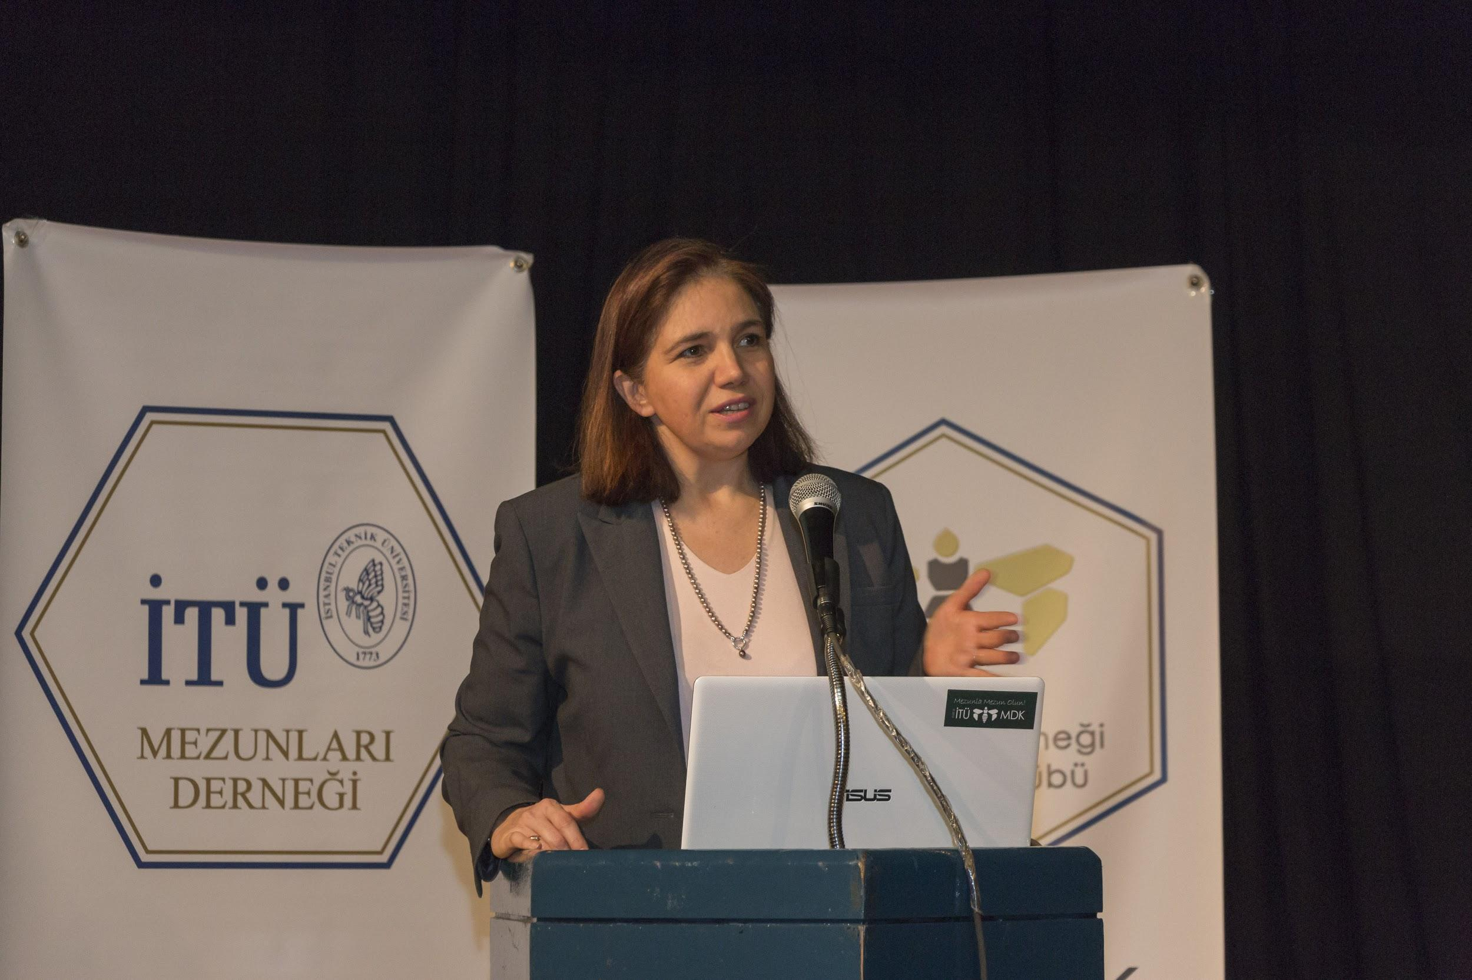
About Us – IŞık Deliorman Aydın
Executive at ICT Multinationals for 23+ years
Entreprenuer, Novida in Turkey & Montenegro
Novida as well part of Group Co.
Project Manager, Consultant, Coach, Mentor
Trainer, Moderator, Speaker
Transforms (Business) Dreams into Reality
Strategist and Systems Thinker
Designer and Synthesizer
Growth and Impact Seeker
For More Please Check LinkedIn Profile

Slide 25
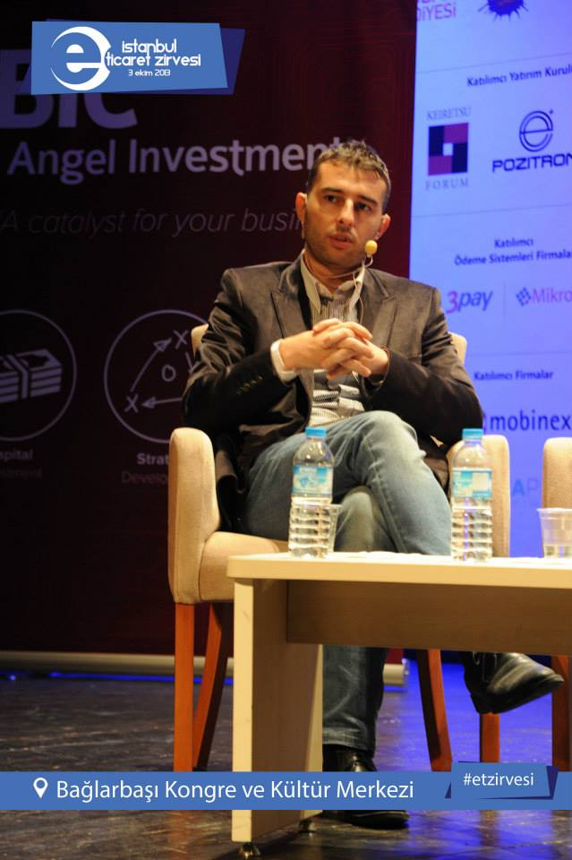
About Us – Kaan Şenol
Serial Entrepreneur, established 3 Start-ups
Investor of 1 Start-up
Mentoring Entrepreneurs in Girişim Hareketi
Regional Partner of FasterCapital
Ex-Sales Manager of an International Company
For More Please Check LinkedIn Profile

Slide 26
CONFIDENTIAL
Thank You!
Işık Deliorman Aydın
Founder & CEO
Novida Strategic Management Services, Turkey
Novida Investment & Consulting, Montenegro
info@novida.com.tr
+90 533 484 4675
Kaan Şenol
Founder
Voyoger

